Slide 1
Google Landmark Recognition 2019
Berthold Aghokeng
Teodor Chiaburu

Slide 2
Table of contents
Overview
Data set
Challenges
Strategy

Slide 3
1. Overview
Last year Google released the largest world-wide dataset at that time containing images of landmarks
Two online challenges have been launched:
Find a solution to label famous (and not-so-famous) landmarks in images
Retrieve similar pictures with the identified landmark from a database
Purpose: foster advancements in research on instance-level recognition and image retrieval

Slide 4
1. Overview
2019: sequel of the competition
-> Google-Landmarks-v2
Even larger and more diverse data set
Release of source code and papers published for top classifiers from previous edition
Novel approaches on describing landmark features:
DELF (DEep Local Features)

Slide 5
2. Dataset
Over 5M images (2x as many as previous year) of more than 200k categories (7x more than in 2018).
~4.1M images in train set (labeled, each contains only one landmark)
~120k images in the test set (unlabeled, each image may contain one, more than one or no landmark)
~760k images in the index set (used as database for image retrieval)

Slide 6
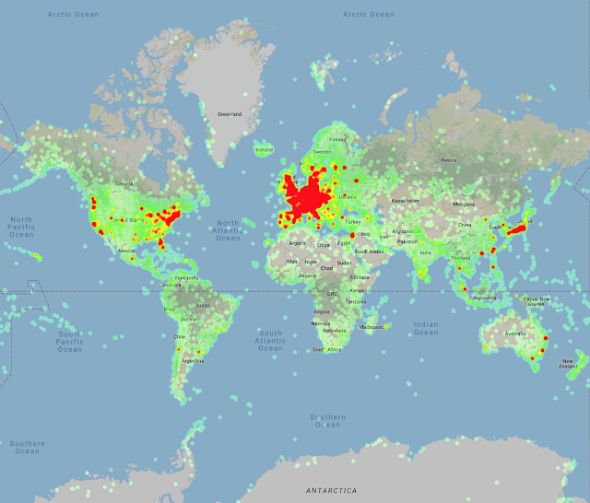
Heatmap of the landmark locations in Google-Landmarks-v2

Slide 7
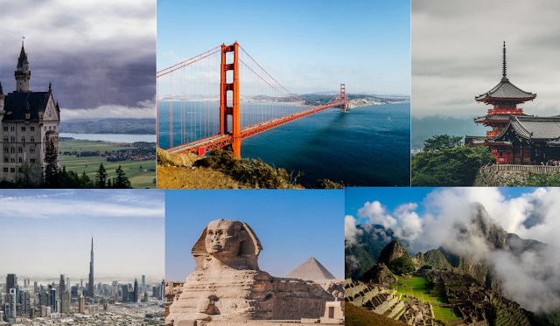
Selection of images from Google-Landmarks-v2. Landmarks include (left to right, top to bottom) Neuschwanstein Castle, Golden Gate Bridge, Kiyomizu-dera, Burj khalifa, Great Sphinx of Giza, and Machu Picchu.

Slide 8
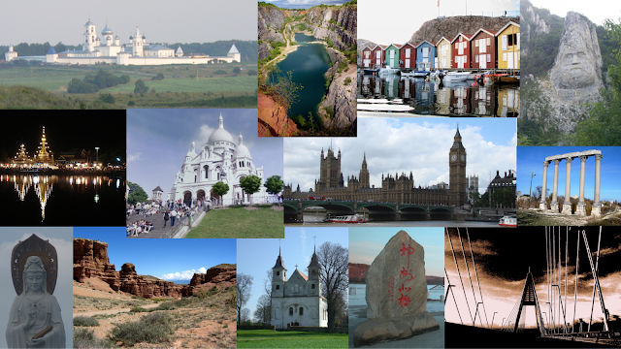
A few examples of images from the Google-Landmarks dataset, including landmarks such as Big Ben, Sacre Coeur Basilica, the rock sculpture of Decebalus and the Megyeri Bridge, among others.

Slide 9
3. Challenges
Uniqueness of each class (landmark) -> there is only one (German) Brandenburger Gate
Generation of training data only through variation of factors such as perspective, ilumination, scale, crop, season (Charlottenburg Garden in summer vs winter)
Unequal number of training images for each category (e.g. there are much more pictures of the Eiffel Tower than of the Decebalus Sculpture)

Slide 10
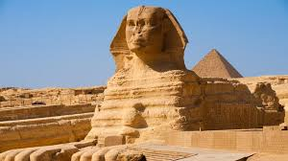
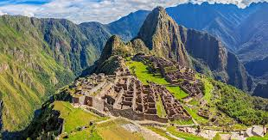
3. Challenges
Some landmarks have much more complex fetures than others (Sphinx vs. Machu Pichu)

Slide 11

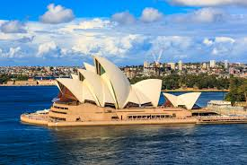

3. Challenges
A lot of very hard to recognize or even ‚rubbish‘ fotos in the training set…

Slide 12
4. Strategy
Transfer learning: use ResNet50 as a pretrained model
Freeze parameters of pretrained convolutional layers and try different architectures for the fully connected layers
Optimize hyperparamters such as learning rate, number of hidden layers, number of nodes per hidden layer, activation functions…
Select a subset from the training set first (maybe only a few well known landmarks, that each appear in at least 1000 images in the dataset)
Only take equal number of images for all selected categories (100 for each class?)
Maybe train on ‚cleaned‘ images first (no crabs in the ‚Sydney Opera‘ section)
Can we get better results if we then unfreeze the convolutional layers, as well?
Increase complexity: more categories, more images per class, unbalanced classes, train on uncleaned data now (crabs are welcome now :^) )

